Slide 1
Preparation and Demonstration of Various Culture Media

Slide 2
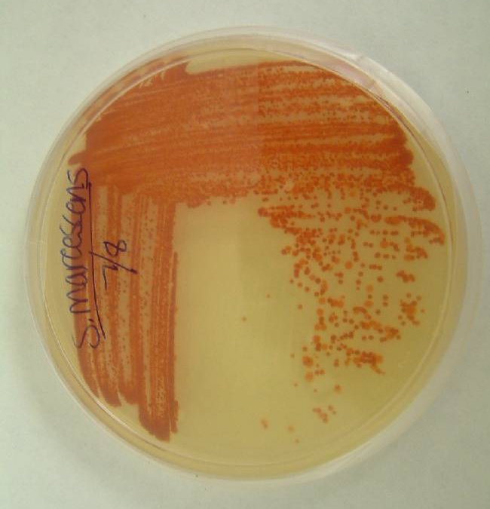
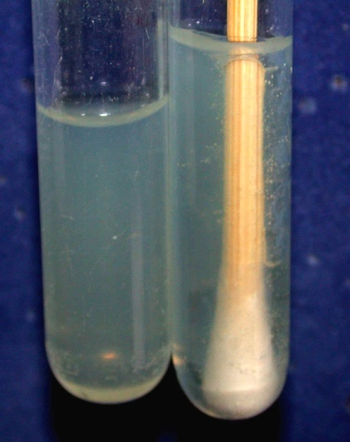
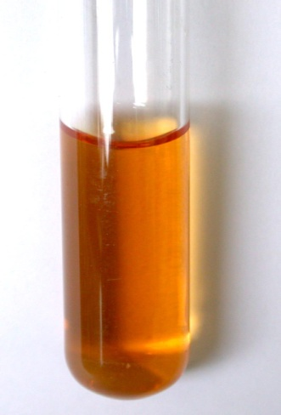
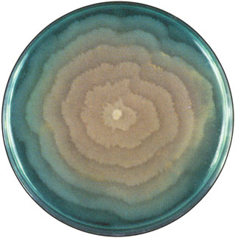
Culture Media

Slide 3
-Media are the substances over which micro-organisms such as bacteria, viruses, fungi etc are cultured or grown to harvest in a larger amount. You all know that individual micro-organism is too small and therefore they are required in larger amount for their evaluation.
Depending upon the special needs of particular bacteria (as well as particular investigators) a large variety and types of culture media have been developed with different purposes and uses.
Culture media are employed in the isolation and maintenance of pure cultures of bacteria and are also used for identification of bacteria according to their biochemical and physiological properties..

Slide 4
Essential requirements in culture media
Any culture medium must contains:
-A source of energy
-Sources of carbon, nitrogen, sulfur, phosphorus
-Minerals, e.g., Ca2+, Mg2+, Na+
-Vitamins and growth factors
- Water

Slide 5
Agar
Complex polysaccharide
Used as solidifying agent for culture media in
petri plates, slants.
Generally not metabolized by microbes
Liquefies at 100°C
Solidifies at 40°C

Slide 6
Types of culture media
1-Based on their consistency
a) solid medium
b) liquid medium
c) semi solid medium
2-Based on the constituents/ ingredients
a) simple medium
b) complex medium
c) synthetic or defined medium
d) Special media

Slide 7
3-According to Function/Application Special media
Basal/ordinary/general
Enriched: with enrichment substances
Enrichment
Selective media: with inhibitory substances
Differential media: with indicators/dyes
Special Media for Biochemical Testing
Media for Antimicrobial Susceptibility Testing
4- Based on Oxygen requirement
- Aerobic media
- Anaerobic media

Slide 8
Solid media – contains 2% agar
Colony morphology, pigmentation, hemolysis can be appreciated.
Eg: Nutrient agar, Blood agar
Liquid media – no agar.
For inoculum preparation, Blood culture, for the isolation of pathogens from a mixture.
Eg: Nutrient broth
Semi solid medium – 0.5% agar.
Eg: Motility medium

Slide 9
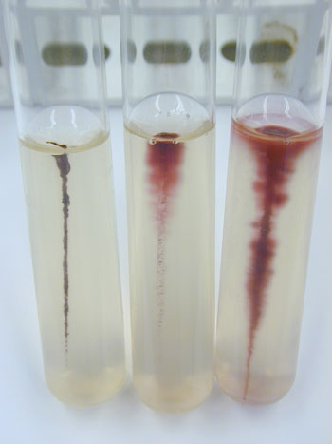

Slide 10
Simple media / basal media
- Eg: NB, NA
- NB consists of peptone, meat extract, NaCl,
- NB + 2% agar = Nutrient agar

Slide 11
Complex media
Media other than basal media.
They have added ingredients.
Provide special nutrients
Synthetic or defined media
Media prepared from pure chemical substances and its exact composition is known
Eg: peptone water – 1% peptone + 0.5% NaCl in water

Slide 12
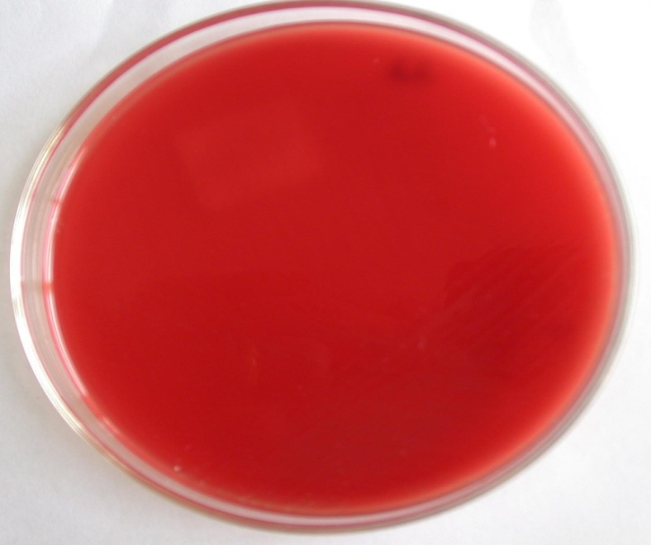
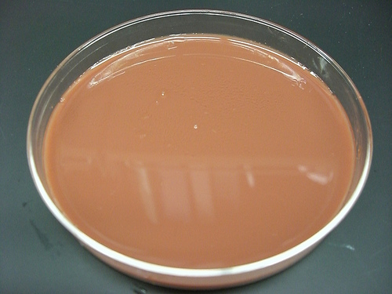
Enriched media
Substances like blood, serum, egg are added to the basal medium.
Used to grow bacteria that are exacting in their nutritional needs.
Eg: Blood agar, Chocolate agar
Blood agar
Chocolate agar

Slide 13
Enrichment media
Liquid media used to isolate pathogens from a mixed culture.
Media is incorporated with inhibitory substances to suppress the unwanted organism.
Eg:
Selenite F Broth – for the isolation of Salmonella, Shigella
Alkaline Peptone Water – for Vibrio cholerae

Slide 14
Selective media
The inhibitory substance is added to a solid media.
Eg:
Mac Conkey’s medium for gram negative bacteria
TCBS – for V.cholerae
LJ medium – M.tuberculosis
Wilson and Blair medium – S.typhi
Potassium tellurite medium – Diphtheria bacilli

Slide 15
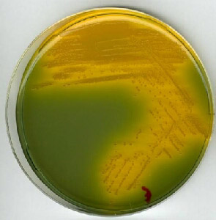
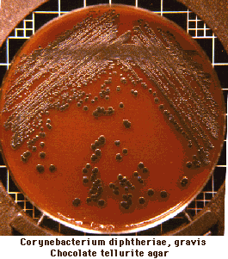
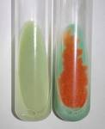
Mac Conkey’s medium
TCBS
Potassium Tellurite media
LJ media

Slide 16
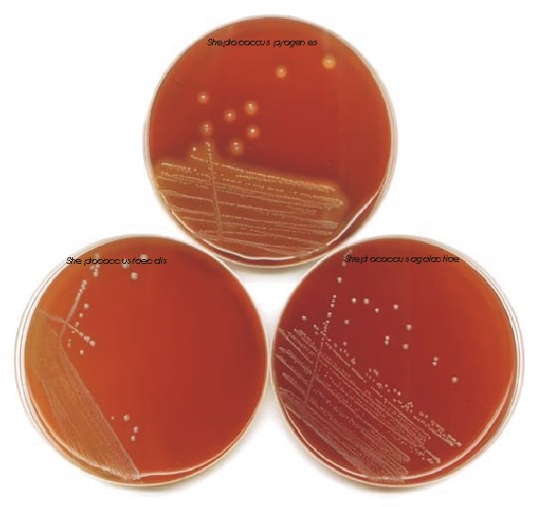
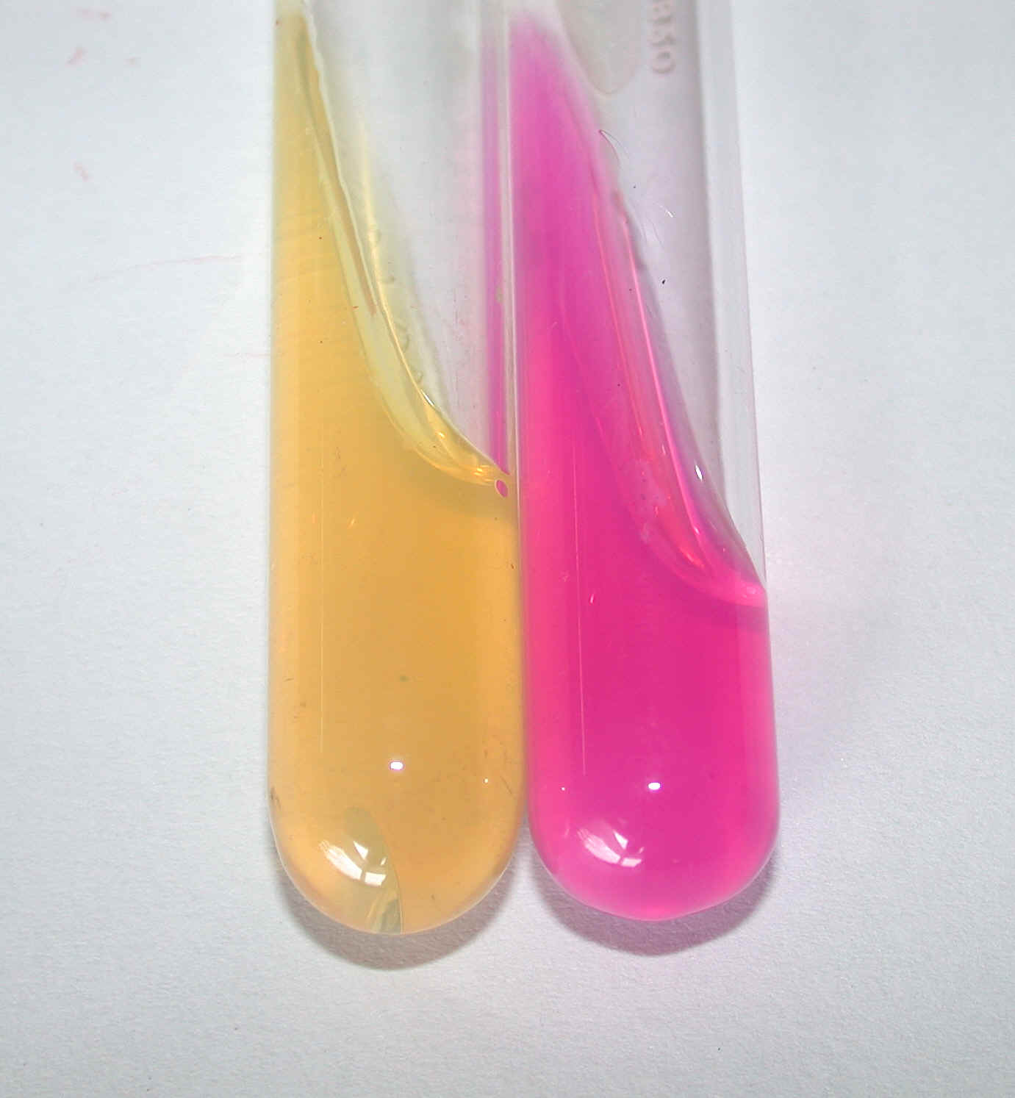
Indicator media
These media contain an indicator which changes its colour when a bacterium grows in them.
Eg:
Blood agar
Mac Conkey’s medium
Christensen’s urease medium

Slide 17
Differential media
A media which has substances incorporated in it enabling it to distinguish between bacteria.
Eg: Mac Conkey’s medium
Peptone
Lactose
Agar
Neutral red
Taurocholate
Distinguish between lactose fermenters & non lactose fermenters.

Slide 18
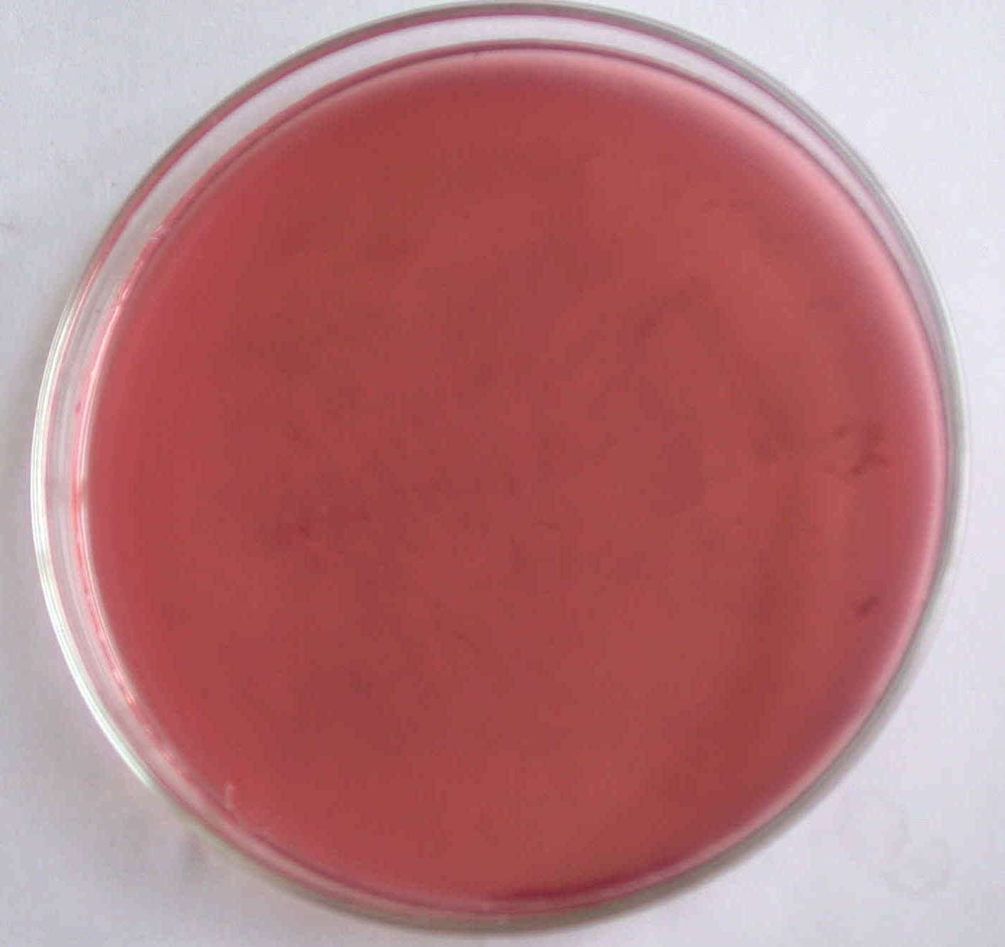
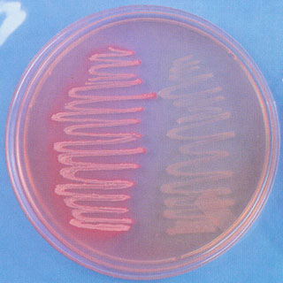
Lactose fermenters – Pink colonies
Non lactose fermenters – colourless colonies

Slide 19
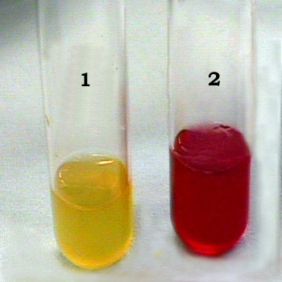
Sugar media
* Media containing any fermentable substance.
Eg: glucose, arabinose, lactose, starch etc.
* Media consists of 1% of the sugar in peptone water.
Contain a small tube (Durham’s tube) for the detection of gas by the bacteria.

Slide 20
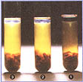
Transport media
Media used for transporting the samples.
Delicate organisms may not survive the time taken for transporting the specimen without a transport media.
Eg:
Stuart’s medium – non nutrient soft agar gel containing a reducing agent
Buffered glycerol saline – enteric bacilli
Anaerobic media
These media are used to grow anaerobic organisms.
Eg: Robertson’s cooked meat medium, Thioglycolate medium.

Slide 21
Requirements
Generally following equipments, glass wares and chemicals are required for
preparation of media.
i) Autoclave (Portable)
ii) Balance
iii) Heating mantle( water bath)
iv) pH meter
v) Laminar air flow
Preparation of Media
vi) Stirrer
vii) Pipettes
viii) Distilled water
ii) Media
x) Test tubes
xi) Beakers
xii) Cotton plugs
xiii) pH paper
xiv) Measuring cylinder

Slide 22
THANK YOU

